Slide 1
Top-Down Syntax Analysis – ELL(k)
Prof. A. Morzenti

Slide 2
TOP-DOWN ANALYSIS WITH RECURSIVE PROCEDURES
Simple and elegant: one procedure for each nonterminal
Top down parsing procedures are guided directly by the transition diagrams of the machines
they determine the nonterminal from which a (sub)string is derived
very soon, when the first character of that string is read
When in the automaton there are bifurcations, to decide which one to follow
one must consider the symbols that may be expected following every arc,
including those on the arcs «exiting the machine» from the final states

Slide 3

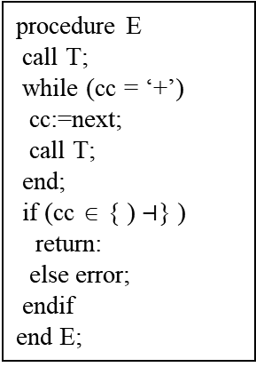
Example – Arithmetic expressions
Symbols expected on exit arcs from final states
E → T (+ T )*
T → F ( × F )*
F → a | ‘(’ E ‘)’
M_{E}:
T
+
0_{E}
1_{E}
2_{E}
T
{ ) $⊣$ }
cc is current char,
symbol under input head
updated by the next procedure
procedure E
call T;
while (cc = ‘+’)
cc:=next;
call T;
end;
if (cc ∈ { ) $⊣$} )
return:
else error;
endif
end E;
machines are annotated with information to allow for a unique choice in presence of forks
when a guide set added to an arc it tells which chars are encountered following the arc
in case of forks the guide sets on all transitions must be disjointed

Slide 4
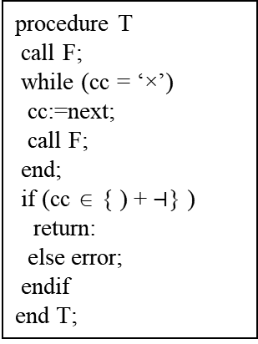

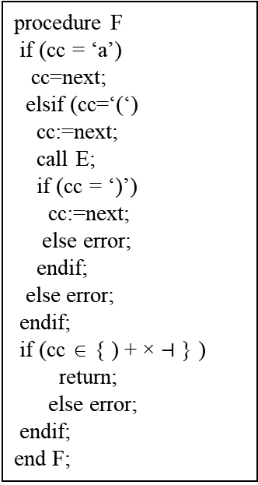

Example (continued) – Arithmetic expressions
E → T (+ T )*
T → F ( × F )*
F → a | ‘(’ E ‘)’
0_{F}
a
2_{F}
M_{F}:
(
{ ) + × $⊣$ }
)
1_{F}
E
3_{F}
M_{T}:
0_{T}
F
×
2_{T}
procedure F
if (cc = ‘a’)
cc=next;
elsif (cc=‘(‘)
cc:=next;
call E;
if (cc = ‘)’)
cc:=next;
else error;
endif;
else error;
endif;
if (cc ∈ { ) + × $⊣$ } )
return;
else error;
endif;
end F;
1_{T}
F
{ ) + $⊣$ }
procedure T
call F;
while (cc = ‘×’)
cc:=next;
call F;
end;
if (cc ∈ { ) + $⊣$} )
return:
else error;
endif
end T;

Slide 5
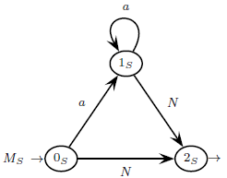



NB: this method does not work if
the sets of possible symbols on arcs outgoing from a single state (the «guide sets»)
are not disjointed
Example: S → a* N N → aNb | ε L={ a^{n} b^{m} | n ≥ m ≥ 0}
{b $⊣$ }
procedure S
if (cc=‘a’)
?? call N; ??
?? cc:=next; ??
...
end S;
{a $⊣$ }
NB: the language of this grammar cannot be analyzed by the top-down method, …
… but it can be analyzed by the bottom-up method, which is more powerful

Slide 6


Another Example – List of odd-length palindromes, separated by an ‘s’
(NB: it is a nondeterministic language: even the bottom-up method does not work)
S → P ( s P )*
P → aPa | bPb | a | b
procedure P
if ( cc = ‘a’ )
cc:=next;
if ( cc ∈ {a b} )
?? call P; ??
?? return; ??
...
end P;
P
1_{P}
{a b}
2_{P}
a
a
{a b s $⊣$ }
M_{P} :
0_{P}
5_{P}
b
b
the
procedure cannot decide based on the next symbol
P
3_{P}
{a b}
4_{P}
{a b s $⊣$ }

Slide 7
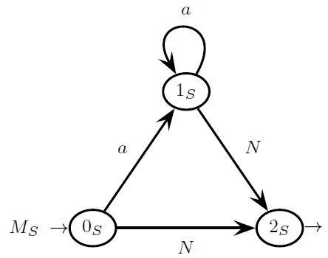
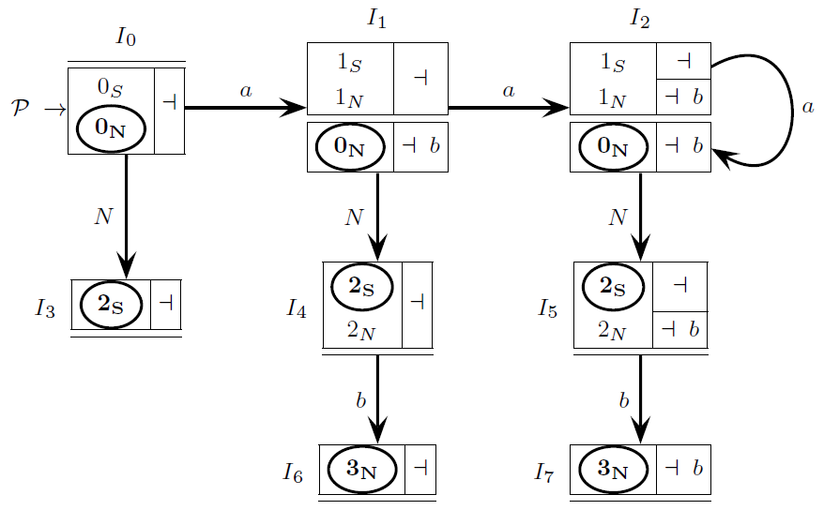

WHAT CAN PREVENT TOP-DOWN PARSING - 1 - MULTIPLE TRANSITIONS
An m-state I has multiple transitions if <p, π>,<r,ρ>∈I and both δ(p, X) and δ(r, X) are defined
Example: grammar S → a* N N → aNb | ε : multiple transitions between I₀ and I₁, I₁ and I₂
multiple transitions originate several analysis threads, typical of bottom up (ELR) analysis
several hypotheses are simultaneously investigated
this prevents top-down parsing, where only one analysis hypothesis is considered
Absence of multiple transitions is called Single Transition Property (STP)
(NB: multiple transitions must not be confused with convergent arcs …
… but STP ensures absence of convergent arcs:
if STP holds the pilot has no pairs of distinct paths that might possibly rejoin)

Slide 8
WHAT CAN PREVENT TOP-DOWN PARSING - 2 - LEFT RECURSIVE DERIVATIONS
A derivation A $\underset{⇒}{+}$ Av, with v ≠ ε , is called left recursive
It derives from rules with left recursion, either direct or indirect
possibly in presence of nullable nonterminals
Example: E → X E + a | a X → ε | b - derivation: E ⇒ X E + a ⇒ E + a
Presence of left recursive derivations prevents top-down deterministic analysis
1_{A}
Example:
A {a, b, …}
A:
a
0_{A}
2_{A}
{a}
B {b, …}
3_{A}

Slide 9
ELL(1) CONDITION FOR A GRAMMAR
A grammar G, represented as a machine net, is ELL(1) iff:
1. The pilot automaton satisfies the ELR(1) condition
2. There are no left recursive derivations
3. The pilot automaton has no multiple transitions (STP condition is satisfied)
NB: therefore the family of ELL(1) languages is a subset of the ELR(1) languages
ELR(1) is a more general/powerful method than ELL(1)
apparently, to check the ELL(1) condition it is necessary to build the pilot automaton
actually, it is not necessary, we can avoid pilot construction

Slide 10
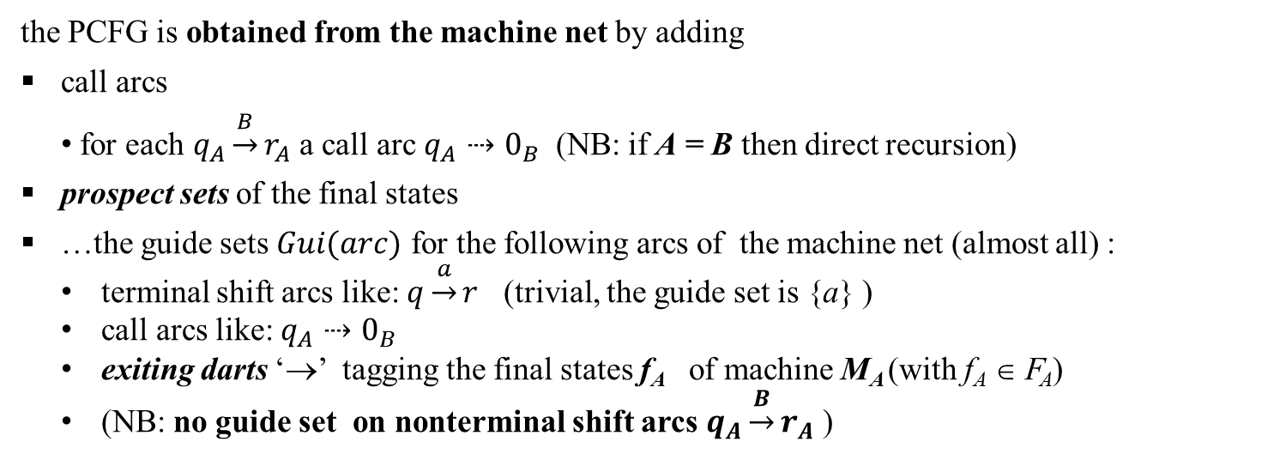
THE ELL(1) CONDITION CAN BE CHECKED
BY BUILDING THE PARSER CONTROL FLOW GRAPH (PCFG)
From the PCFG one can easily derive (also manually) the parser program code
the parser code consists of a set of recursive procedures, one for each nonterminal
the PCFG is obtained from the machine net by adding
call arcs
for each $q_{A}\underset{→}{B}r_{A}$ a call arc $q_{A}⇢0_{B}$ (NB: if A = B then direct recursion)
prospect sets of the final states
…the guide sets $Gui(arc)$ for the following arcs of the machine net (almost all) :
terminal shift arcs like: $q\underset{→}{a}r$ (trivial, the guide set is {a} )
call arcs like: $q_{A}⇢0_{B}$
exiting darts ‘→’ tagging the final states f_{A} of machine M_{A} (with f_{A} ∈ F_{A})
(NB: no guide set on nonterminal shift arcs $q_{A}\underset{→}{B}r_{A}$ )

Slide 11
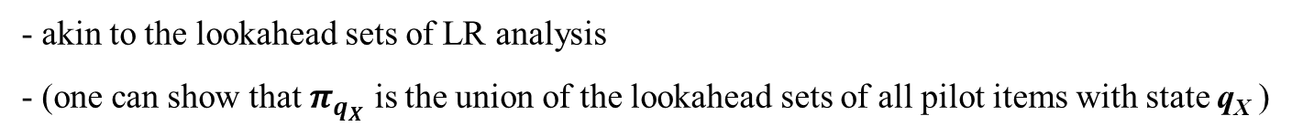
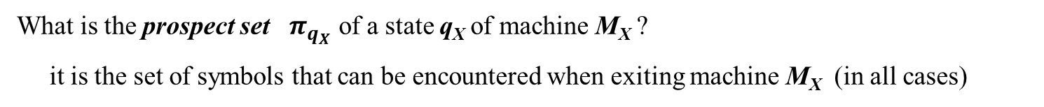
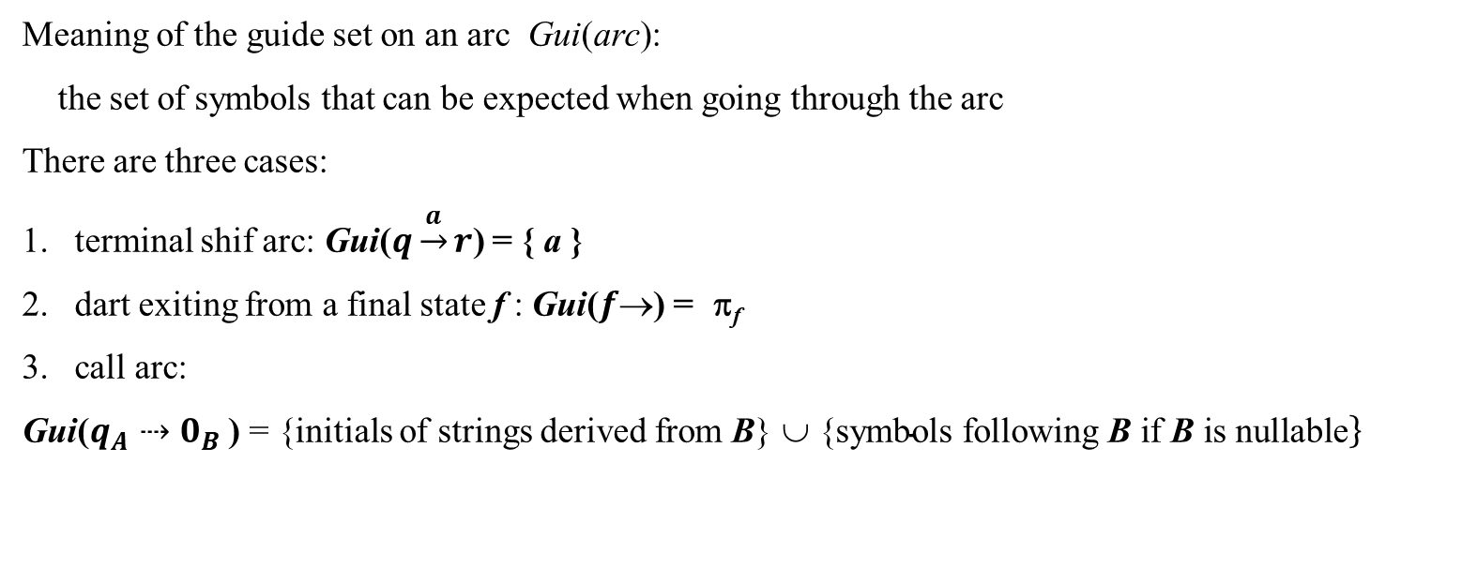
What is the prospect set $π_{q_{X}}$ of a state q_{X} of machine M_{X} ?
it is the set of symbols that can be encountered when exiting machine M_{X} (in all cases)
- akin to the lookahead sets of LR analysis
- (one can show that $π_{q_{X}}$ is the union of the lookahead sets of all pilot items with state q_{X} )
Meaning of the guide set on an arc Gui(arc):
the set of symbols that can be expected when going through the arc
There are three cases:
terminal shif arc: Gui($q\underset{→}{a}r$) = { a }
dart exiting from a final state f : Gui($f$) = π_{f}
call arc:
Gui($q_{A}⇢0_{B}$ ) = {initials of strings derived from B} ∪ {$\left.\text{symbol}\text{s} \text{following} \text{B} \text{if} \text{B} \text{is} \text{nullable}\right\}$
Guide sets can be computed (also) manually by simply “inspecting” the machine net
NB: in the coming slides sometimes prospect sets are placed inside the final state

Slide 12
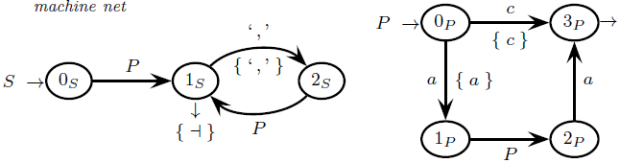
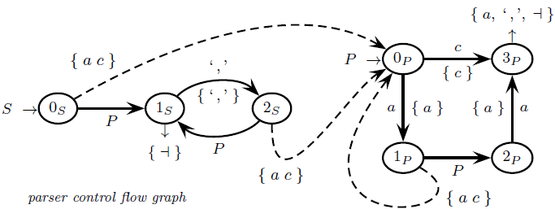
Guide sets for the grammar / machine net
Ex. strings: “aca” “aacaa,aca”
very simple: P not nullable
call arcs
S axiom

Slide 13
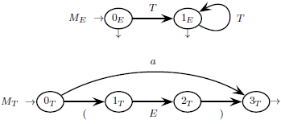
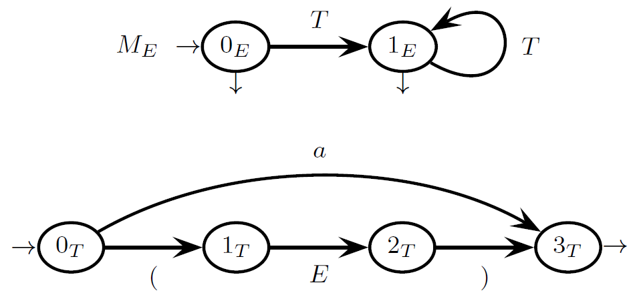
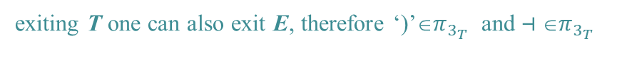


Prospect sets for a grammar / machine net
(we only show those on the final states because they coincide with the guide sets on exit darts )
after T there can be another T: therefore Ini(L(T))={ a ( } ⊆ $π_{3_{T}}$
$$π_{0_{E}}=π_{1_{E}}=\{ ⊣ ) \}$$
E is the axiom
$$π_{3_{T}}=\left\{ \right) ( a ⊣ \}$$
exiting T one can also exit E, therefore ‘)’∈$π_{3_{T}}$ and $⊣$∈$π_{3_{T}}$

Slide 14
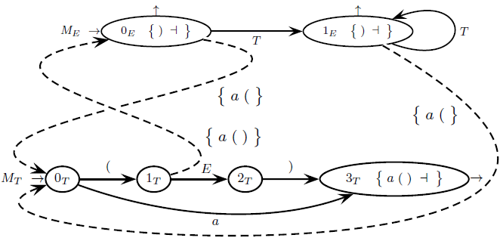
Guide sets for a grammar / machine net
call arcs
=Ini(L(T))
Idem
Gui($1_{T}⇢0_{E}$) = { a ( ) } because { ‘(’ a } = Ini(E) and E is nullable and { ‘)’ } = Ini(L(2_{T}))

Slide 15
In the PCFG almost all arcs (except for the NONterminal shift) are interpreted as conditional instructions
terminal shift arcs p $\underset{→}{a}$ q are gone through if current char cc = a
call arcs q_{A} $⇢$0_{B} are gone through if current char cc∈Gui(q_{A} $⇢$ 0_{B})
exit arcs f_{A}→ from a node with prospect set $π_{f_{A}}$ are gone through if current char cc ∈ $π_{f_{A}}$ = Gui(f_{A}→)
instead NONterminal shift arcs p $\underset{→}{A}$ q are interpreted as (inconditional) «return from machine call»
It can be proved that
disjointed guide sets on alternative arcs ⇔ ELL(1) condition satisfied
Therefore
ELL(1) condition can be checked through the guide sets, without building the pilot automaton :-)
top-down syntax analysis is possible iff guide sets are disjointed

Slide 16
PARSER IMPLEMENTATION BY MEANS OF RECURSIVE PROCEDURES
the PCFG is translated into a set of parameterless recursive procedures
(⇒ one procedure for each nonterminal)
call arc ⇒ procedure call
terminal shift arc ⇒ call of next procedure (interface to the scanner/lexical analyzer)
final state dart ⇒ procedure return
guide sets are used to choose the next move
the analysis starts by invoking the procedure for the axiom
the technique is called recursive descent

Slide 17
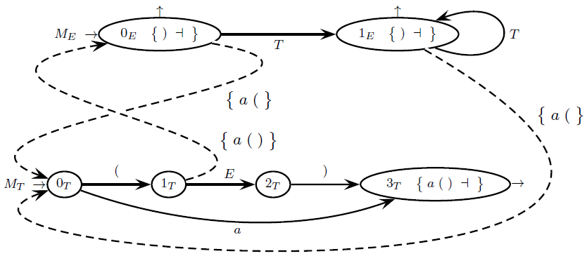
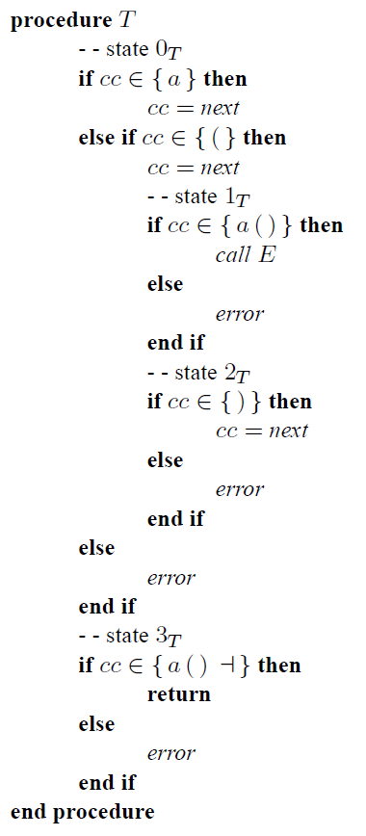
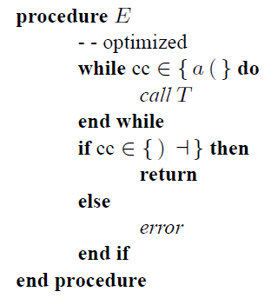
running example

Slide 18
INCREASING THE LOOKAHEAD FOR NON-ELL(1) GRAMMARS
If a grammar is not ELL(1) it sometimes may be possible to transform it to make it ELL(1)
this transformation can be complex and make the grammar less terse
Possible alternative: increase the lookahead
the parser chooses the next move based on a number k > 1 of input chars
if one obtains disjointed guide sets of length k then the ELL(k) analysis is feasible
we do not provide systematic rules to compute the guide sets with lookahead k ≥ 2
we just inspect the machines to determine them, based on intuition

Slide 19
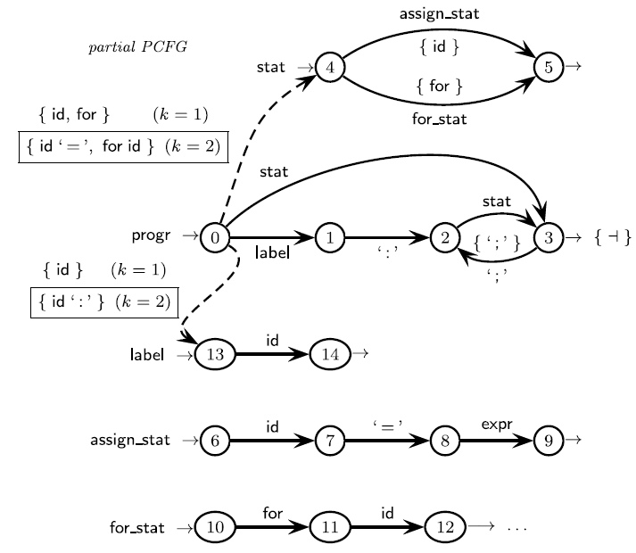
Example: conflict between identifiers of instruction labels and variable names
id is both a label for any instruction
and a variable name in the left side of assignments
To discern one must look beyond the next token
if “id :” ⇒ label
if “id =” ⇒ assignment
NB: guide sets of length k=2 are framed

